Slide 1
Smartphone Screen Orientation
Barrett Honors Thesis
Riley Tallman

Slide 2
Introduction My background
Graduating this semester with undergrad, then 4+1
CSE 471 Intro to AI (Prof Gil)
CSE 494 AI In Cyber Security
CSE 494 Machine Learning
CSE 579 Knowledge Representation and Reasoning
CSE 594 Computer Vision
Self Driving Cars

Slide 3

Introduction The Problem

Slide 4
Solution 1 Pre-trained Models

Slide 5
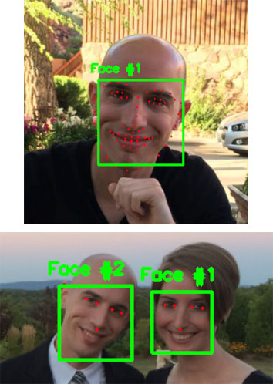


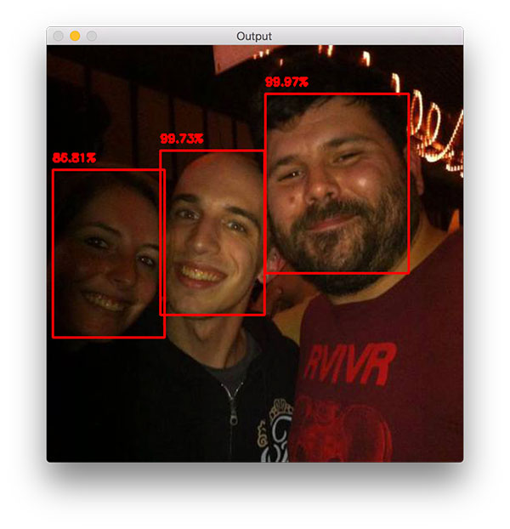
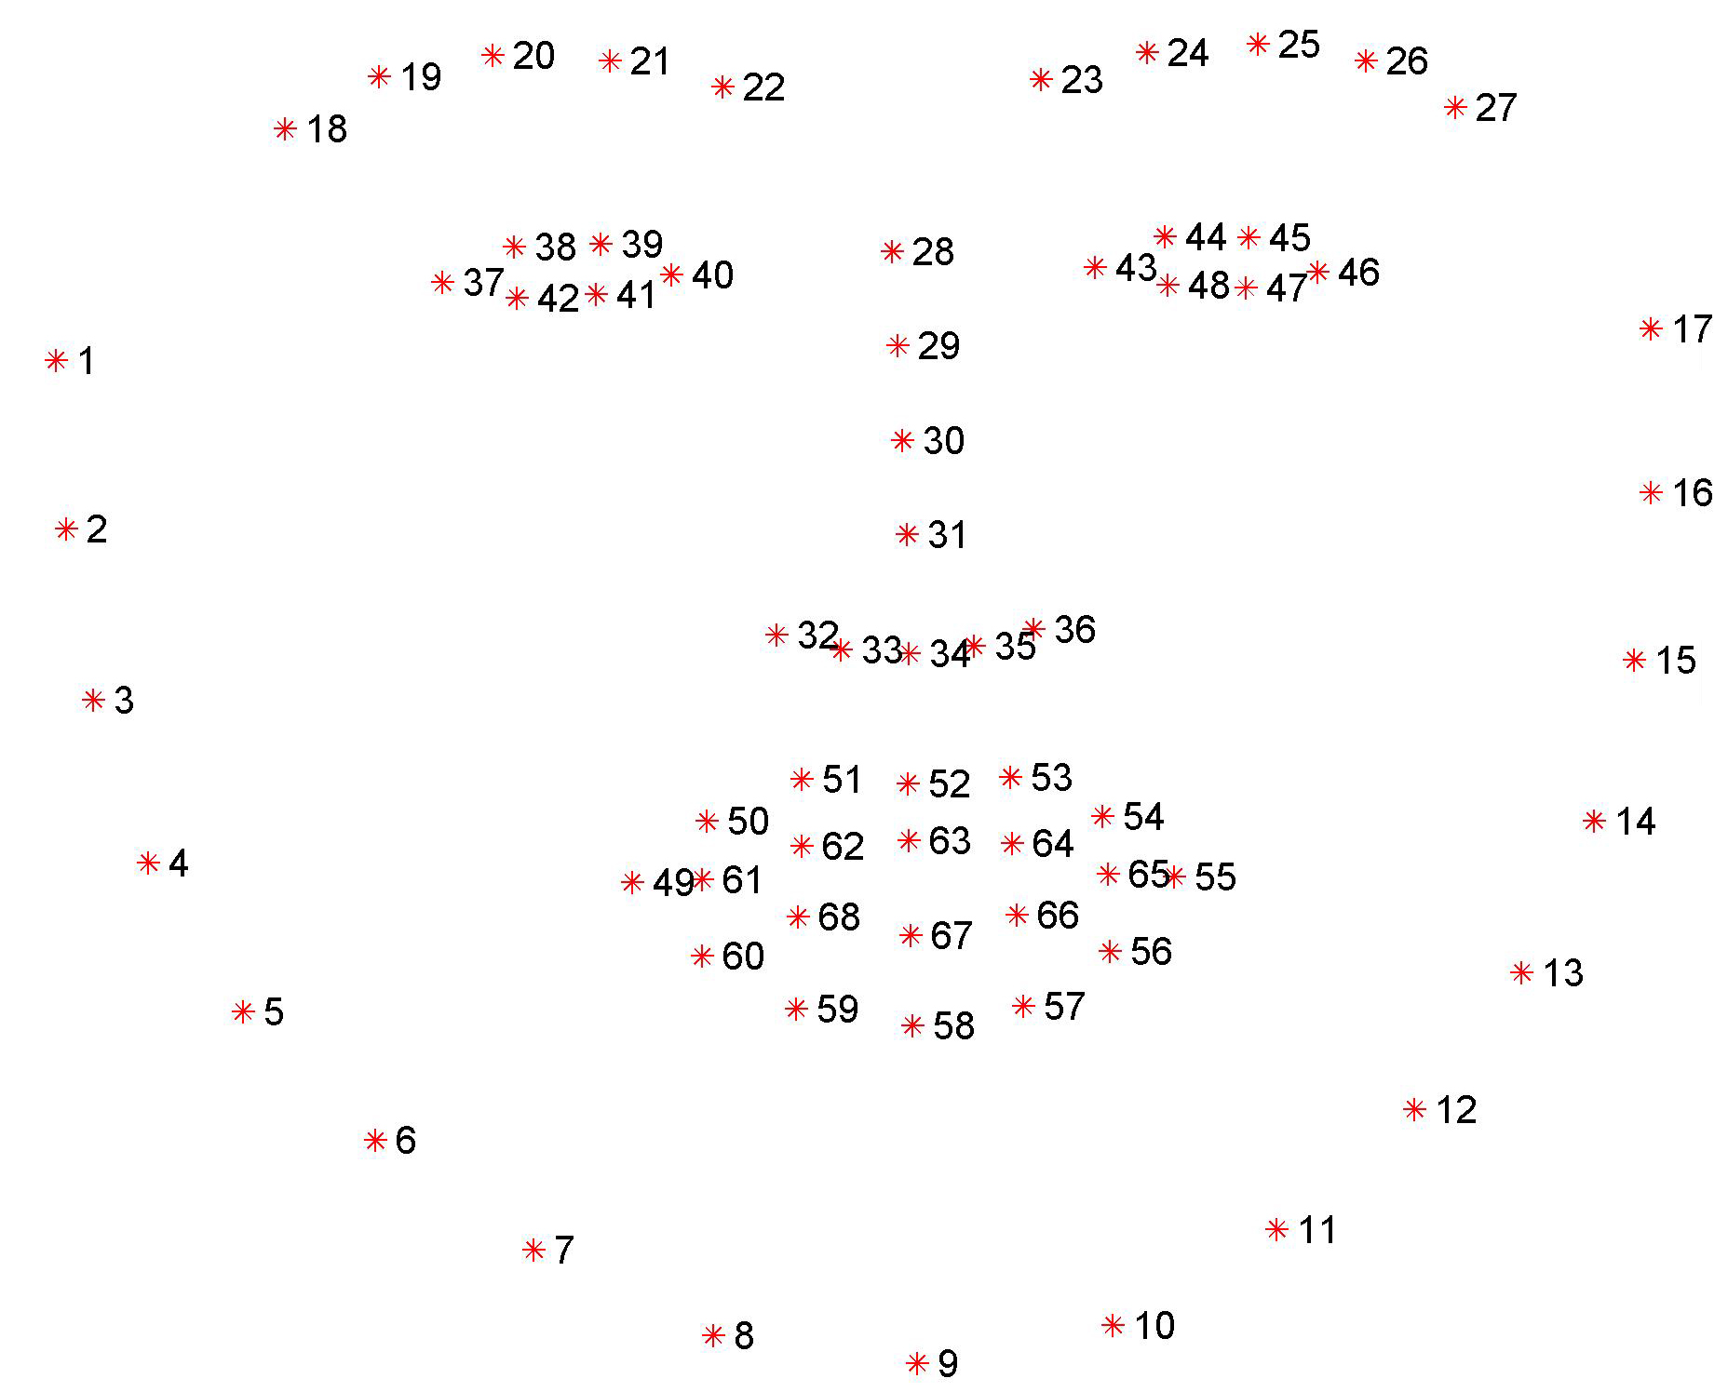
Solution 1 Pre-trained Models
Orientation!
68/5-point landmark detector
https://www.pyimagesearch.com/2017/05/22/face-alignment-with-opencv-and-python/

Slide 6
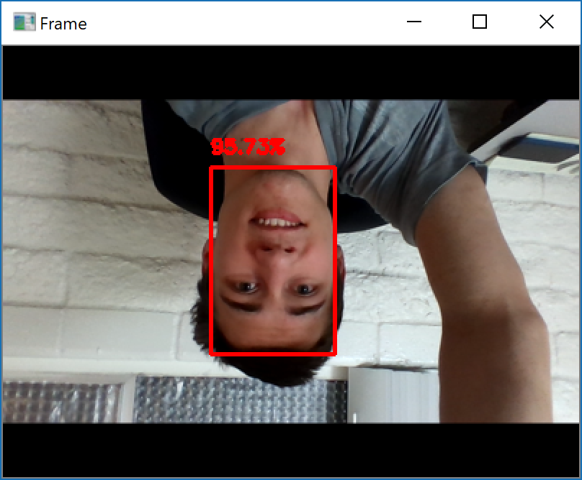
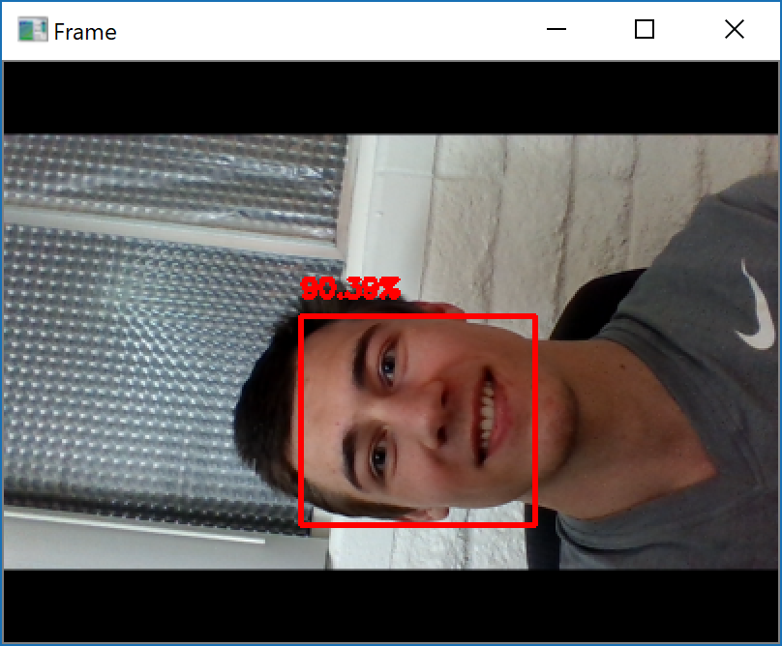
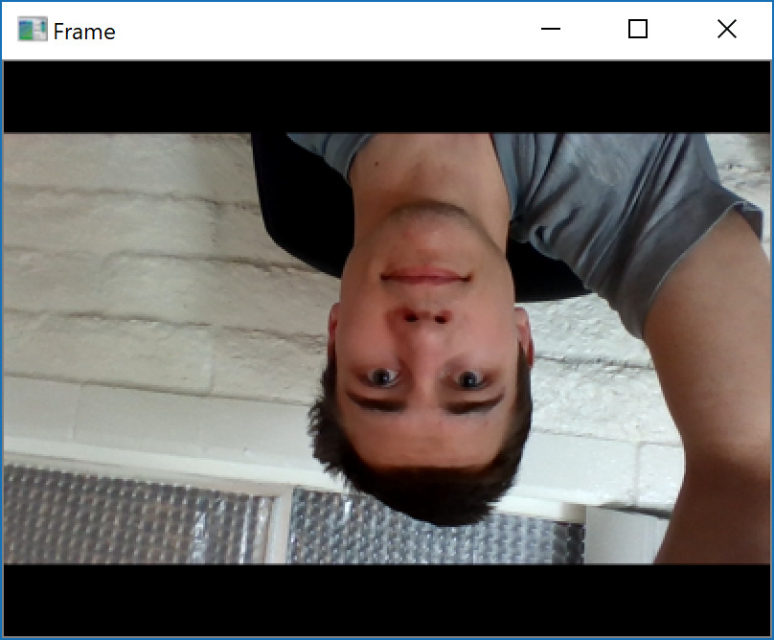
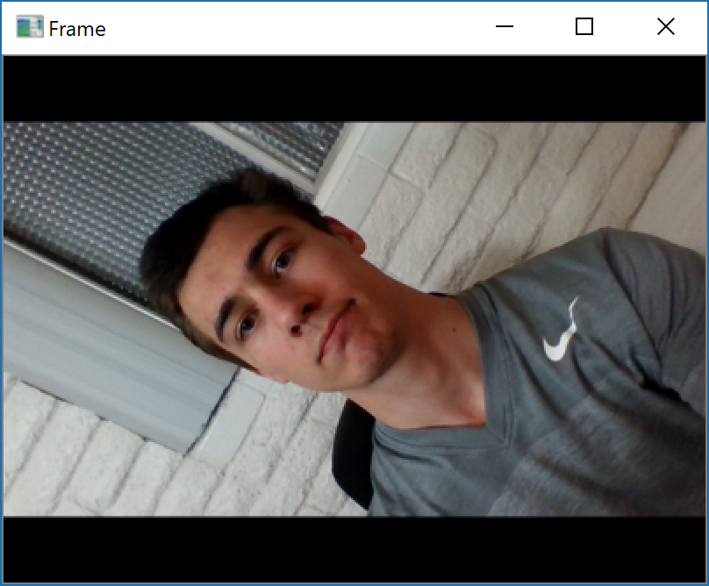
Solution 1 Pre-trained Models
OpenCV
dlib
https://www.pyimagesearch.com/2017/05/22/face-alignment-with-opencv-and-python/

Slide 7

Solution 1 Pre-trained Models
5-point landmark detector
Orientation!
https://www.pyimagesearch.com/2017/05/22/face-alignment-with-opencv-and-python/

Slide 8
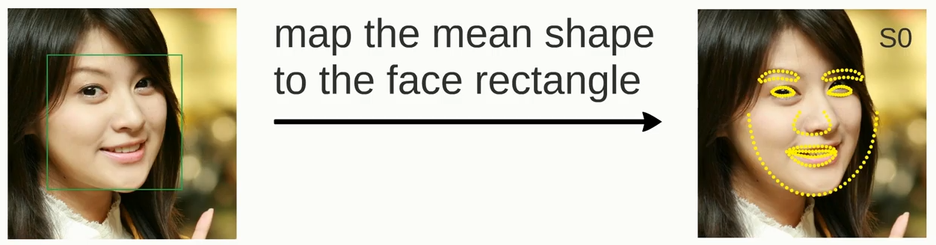
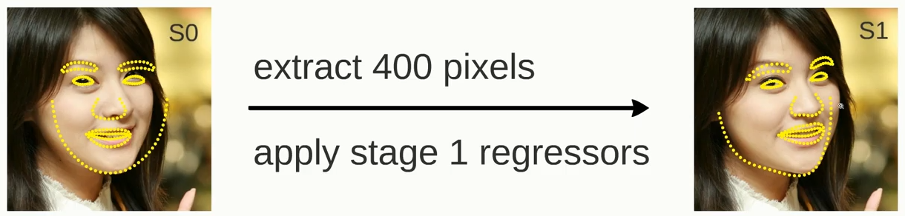
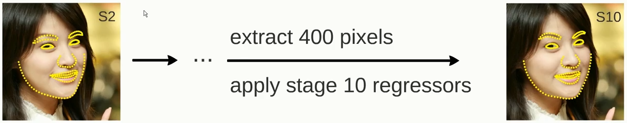
Solution 1 Pre-trained Models – Failure
https://www.youtube.com/watch?v=SLLZr9IjPcE

Slide 9
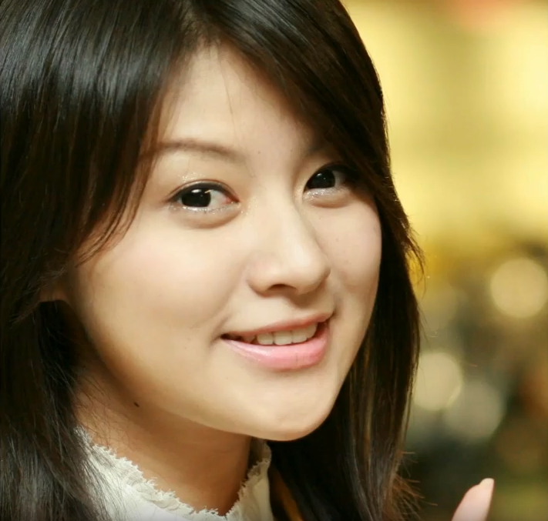

Solution 1 Pre-trained Models – Failure

Slide 10
Solution 2 Pre-trained Models Without 68/5 point

Slide 11
Solution 2 Hack the system
?
?
?

Slide 12
Solution 1 Pre-trained Models
OpenCV
dlib
https://www.pyimagesearch.com/2017/05/22/face-alignment-with-opencv-and-python/

Slide 13


Solution 2 How it works
Rotations
Vertical-only face detector
Input Image from camera
Orientation!

Slide 14
Solution 2 Faced Results
https://towardsdatascience.com/faced-cpu-real-time-face-detection-using-deep-learning-1488681c1602

Slide 15
Solution 3 DIY – design my own😁

Slide 16
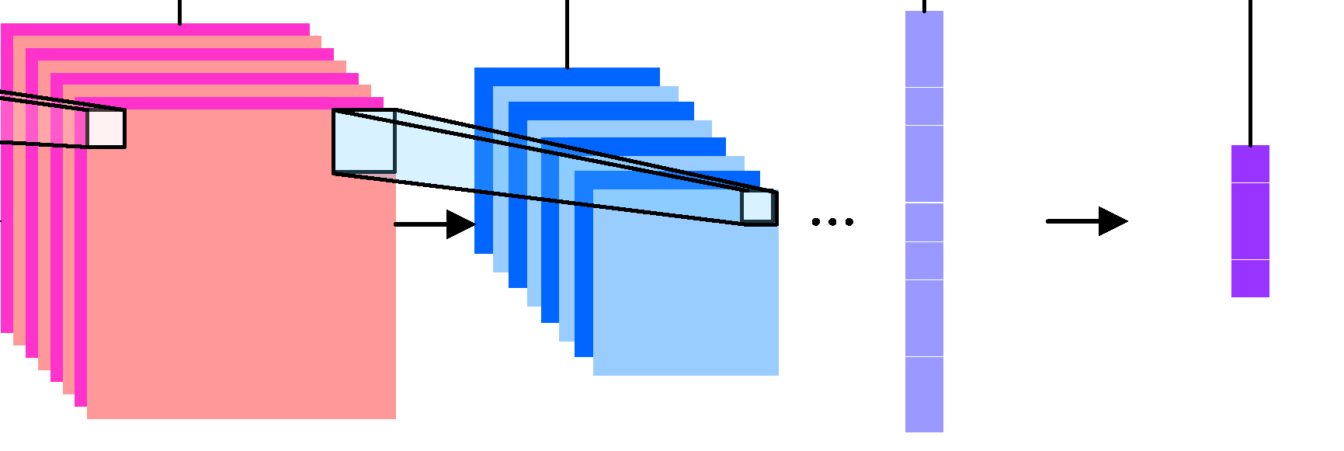
Solution 3 DIY
4-Class Classification, simple!
Input Image from camera
Orientation!

Slide 17
Solution 3 DIY
Helen dataset – looks like selfies
Scaled down to 128x128
Total params: 26,078
VGG style:
Conv – Conv – Pool - Dropout
Conv – Conv – Pool – Dropout
Conv – Conv – Pool – Dropout
Conv – Conv – Pool - Dropout
Dense(16)

Slide 18

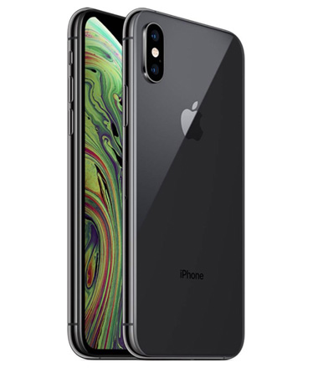
Solution 3 Drawbacks
67% CPU
50% CPU

Slide 19
Speed What is fastest

Slide 20
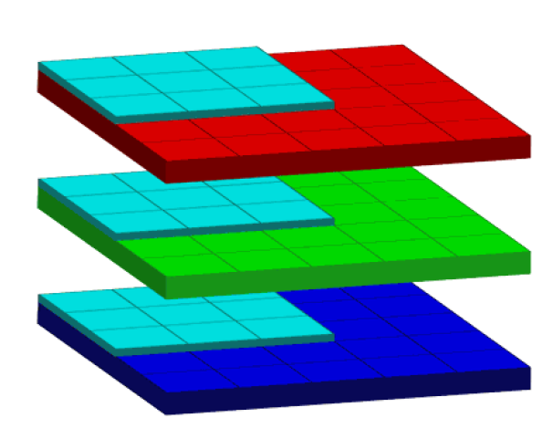
Smartphone Performance Battery Life
Model Size?
Frames per second?
Grayscale vs. RGB?
Work with the accelerometer?
iPhone 6, iPhone XS to test with
Xcode – swift
Working camera application
Battery life!

Slide 21
Efficient Solutions Battery Life!

Slide 22
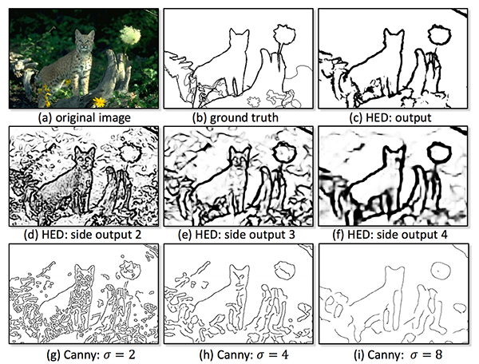
Efficient Solution Preprocessing
Test image processing techniques
Edge detection algorithms
End goal: reduce model size

Slide 23
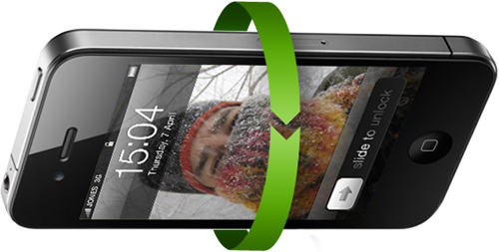
Efficient Solution Accelerometer
If device.willRotate(){
flag = camera_orientation.run()
if flag == true
rotate
else
don’t_rotate
}

Slide 24
Takeaways

Slide 25
Takaways Simplicity
Pre-trained models might be useful, but they are not a golden ticket
Specific use cases require specific models
iOS – Vision Library
I did not do enough research
Could’ve saved time trying to get dlib working on iOS

Slide 26
Questions? Thanks

